Slide 1

Enterprise DataHub

Slide 2
Overview
What is the Enterprise Datahub?
General Onboarding Questions/Steps
The components of the Datahub

Slide 3
What is the Enterprise Datahub?
High-throughput, distributed messaging system
Cross-datacenter integration
Stream processing
Leverages the Confluent Platform built on Apache Kafka
How long has it been around?
Initial poc started - Spring 2015
Production go live - September 2016
Datahub docs site - Home Page
Contact us

Slide 4
Cross-Datacenter Integration
AWS-EU
AWS
GCP
Producers
Consumers
Producers
Consumers
Producers
Consumers
Kafka
Cluster
Kafka
Cluster
Kafka
Cluster
Replicant

Slide 5
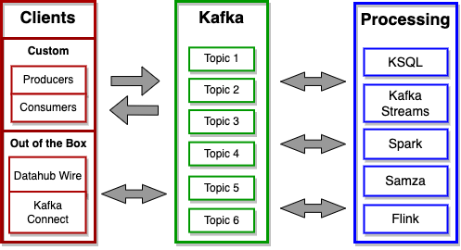
Stream Processing

Slide 6

Apache Kafka
Extremely fast, highly scalable, durable, distributed publish-subscribe messaging platform
Developed at LinkedIn - open sourced 2011
Confluent founded in 2014 as a commercial entity supporting Kafka
Apache Kafka
Confluent
Topic 1
Topic 2
Topic 3
Topic 4
Topic 5
Topic N
Producer
Consumer
Notes:
Point-to-point --> Hub and spoke

Slide 7
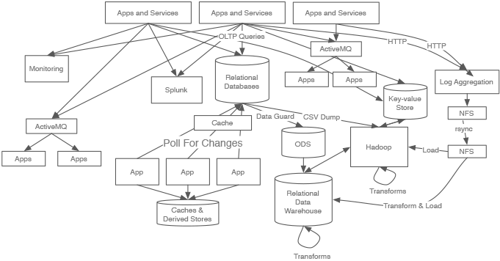
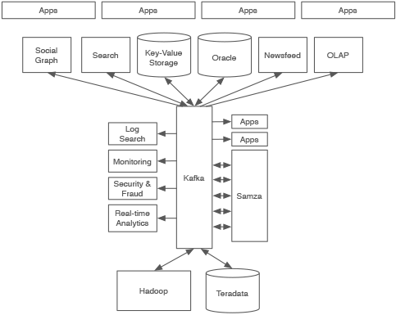
Let’s Clean Up This Mess!
Notes:
Point-to-point --> Hub and spoke

Slide 8
General Onboarding Questions
Define the use case – Is it a good fit for Kafka?
When to use Kafka
Use Cases
Analyze and define data types, volumes and load profile.
Message Structure, Data Types, Volume and frequency of messages.
Determine data security classification.
If unsure contact the Cyber Security Risk Management Team
Define cluster replication requirements
Is replication needed?
How will data be produced into and consumed from EDH?
Location of clients – can the datahub account be reached?
Type of clients – custom or out of the box
Docs Site - Onboarding Data Sources
Notes:
Point-to-point --> Hub and spoke

Slide 9
Connecting to the EDH
Getting connected to the Datahub
Where is your code running? AWS US, AWS EU, GCP, On-Prem
Which cluster will the consumers/producers need to connect to?
Testing your connectivity to EDH
Follow the instructions on the Docs site for your scenario.
Cloud - EDH Cloud Connect
If you need to connect from On-Prem
If there is no connectivity you will need to contact the network team for that datacenter to get firewall rules added.
Notes:
Point-to-point --> Hub and spoke

Slide 10
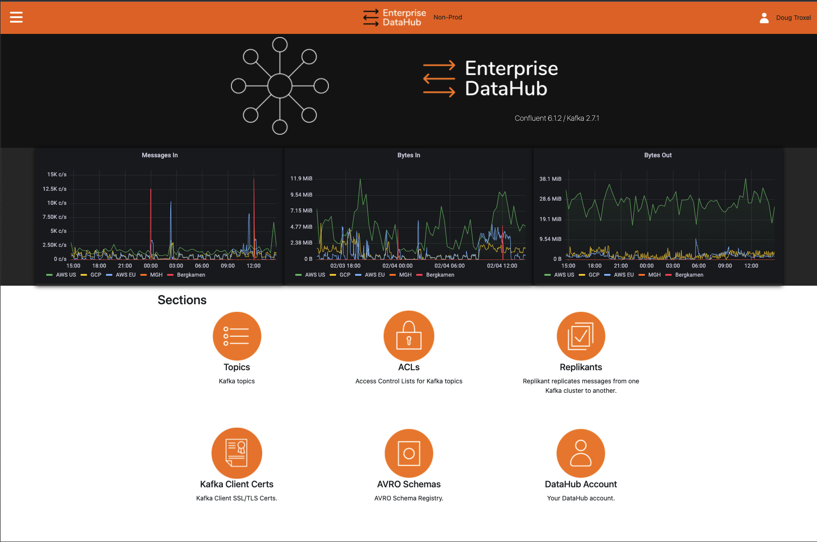
DataHub Portal
Docs Site Info/Guides: https://cloverfield.bayer.com/edh-docs/portal-guide/datahub-portal/
Non-Prod Portal: http://edh-np-portal.bayer.com/
Prod Portal: https://edh-portal.bayer.com/

Slide 11
Topic Group
Topic Group
What is a topic group
Used to manage topic admin privileges on topics.
Assign one or more PAPI groups – members in PAPI have admin access to topics under that topic group
The topic group will be the prefix for the topics
Topic naming convention
Docs Site – Create Topic Group
Notes:
Point-to-point --> Hub and spoke

Slide 12
Create DN
What is a DN?
Manage client certs for connecting to the Datahub.
Used to assign ACLs on topics for permissions
Assign one or more PAPI groups
Members in the PAPI group have admin access to create/delete certs under the DN.
Docs Site – Create DN
Notes:
Point-to-point --> Hub and spoke

Slide 13
Topics
What is a topic?
All messages are published to a topic
Producers publish data to topic and one or more consumers can subscribe to the topic to get the messages.
Create Topic
Topic name
Follow the topic naming pattern
Partitions
One unless there is a good reason to use more.
Can only be increased, so plan accordingly
Retention
Default 7 days
Replication Factor
Default to 3 – up to two brokers can be lost before losing data.
Docs Site – About Topics
Docs Site – Create Topics
Notes:
Point-to-point --> Hub and spoke

Slide 14
Schema
What is a Schema?
Describe the data model of the message
We leverage the Confluent Schema Registry
Provides storage, retrieval and versioning of schemas.
Allows evolution of schemas based on compatibility settings
We use AVRO
Robust evolution capabilities
Why use Schemas?
Promotes data discovery and reuse
Minimizes the impact of changes on downstream consumers
Are schemas required?
Optional
When it doesn’t make sense, for example, error topics or raw data topics
Docs Site - Schemas
Docs Site – Register Schema
Notes:
Point-to-point --> Hub and spoke

Slide 15
ACLs
Access Control Lists
By default, no one can read or write to a topic
Producers typically need write or all permissions
Consumers read permissions
Applied based on DN
Prefixed or Literal
Topic owners' control ACLs and access to topics.
If there is a read or higher ACL on a topic. The members of the PAPI group that owns that DN can read messages in the topic message browser in the Datahub Portal.
Docs Site - Security Overview
Docs Site – Add ACLs
Notes:
Point-to-point --> Hub and spoke

Slide 16
Replication
Topic replication between clusters provided by Datahub
Topic owners can setup/delete replication at anytime
Replication can run between any/all clusters.
Docs Site – Create Replication Task
Notes:
Point-to-point --> Hub and spoke

Slide 17
Generate Cert
What is a cert?
SSL certificate used for authentication, encryption and authorization
The DN defined for the cert is used as the principal for defining topic ACLs.
All clients accessing the EDH must have a valid SSL/TLS certificate
The members of the PAPI group assigned to the DN can generate/delete certs under that DN.
Docs Site - Security Overview
Docs Site – Generating Cert
Notes:
Point-to-point --> Hub and spoke

Slide 18
Clients
Producer
Reads messages from the source and writes messages to Kafka Topic.
Consumer
Reads messages from Kafka Topic and writes messages to target.
Can be custom code or if the use case is supported, out of box solution
Datahub Wire or Kafka Connect
Client teams are responsible for running, monitoring and maintaining client apps/code.
Cert required in client code to connect to the clusters.
Docs Site - Developer Guide
Docs Site – Datahub Wire
Notes:
Point-to-point --> Hub and spoke

Slide 19
Dashboards and Logs
Datahub does provide Kibana logs and Grafana Dashboards for teams to use.
This shouldn’t replace client monitoring/alerting for the teams.
The links are listed on the Metrics and Logging and the Accessing the Environment pages.
There is a public Prometheus end point teams can setup their own custom dashboards/alerting as well.
Docs Site - Metrics and Logging
Docs Site – Accessing the Environment
Notes:
Point-to-point --> Hub and spoke

Slide 20
The End
Links
Datahub Docs
Datahub Portal
Non-Prod
Prod
Microsoft Teams Channel

